Slide 1






Electrostatics-Driven Ensemble Learning Model for Protein pKa Predictions
SONGYUAN YAO
Advisor: Dr. Yihan Shao
Department of Data Science and Analytics
CCATS team

Slide 2
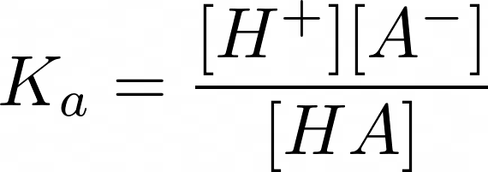
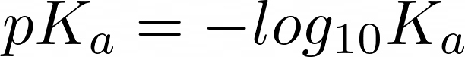
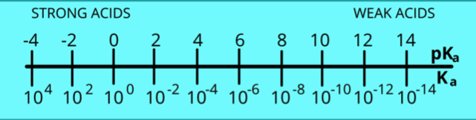
What is pK_{a}?
pKa is the negative base 10 logarithm of the acid dissociation constant (K_{a}).
HA dissociation in water:
Ka calculation:
pKa calculation:
The lower the pK_{a} value, the stronger the acid

Slide 3
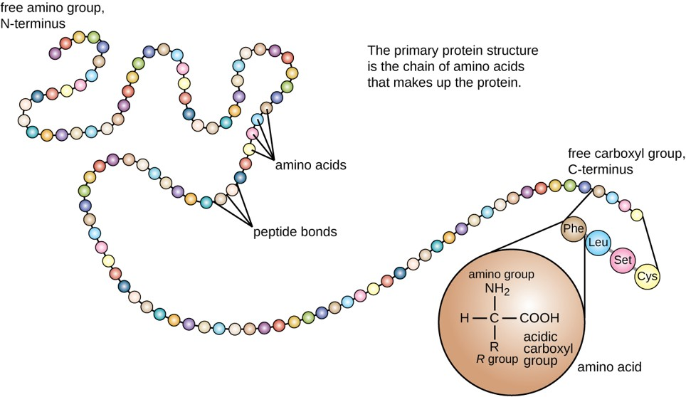
What is protein?
Basic building blocks of protein called amino acids.
20 types of essential amino acid
3 types of positive: histidine (His, H), lysine (Lys, K), and arginine (Arg, R)
2 types of negative: aspartic acid (Asp, D) and glutamic acid (Glu, E)

Slide 4
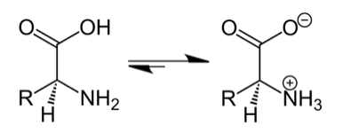
What is protein pKa?
Estimate the pKa values of amino acids as they exist within proteins.
Challenge:
Amnio acid microenvironment
Sample preparation
Experimental limitations
Notes:
Residue microenvironment: The pKa of an ionizable residue in a protein can be influenced by its microenvironment, such as nearby amino acids or solvent accessibility. Therefore, it is important to consider the local structure and environment of the residue when interpreting pKa data.
Sample preparation: The preparation of a protein sample for pKa determination can be challenging, as factors such as protein concentration, purity, and stability can all affect the accuracy of the results. Additionally, care must be taken to avoid introducing any artifacts that could alter the pKa values, such as buffer effects or temperature changes.
Experimental limitations: Some experimental techniques, such as NMR spectroscopy or X-ray crystallography, may be difficult to apply to certain proteins or require specialized equipment or expertise. Additionally, obtaining high-resolution structural information for a protein may be challenging, which can limit the accuracy of pKa predictions based on computational methods.
Multiple ionizable groups: Many proteins contain multiple ionizable residues, which can complicate the determination of individual pKa values. In some cases, it may be necessary to perform multiple experiments or use specialized methods to resolve the contributions of different groups.

Slide 5
Overview
Retrain
FEATURES
MODELS
Ensemble
ResName_XXX
LDA
SVM
Model 1
DATASETS
WT
MT
B_factor
Pretrain
BT
KNN
Model
Selection
Model 2
MODEL
aSN
…
NN
RF
EP
logit
Ridge
Model 3
The experimental pKa values were obtained from the PKAD database.
Electrostatic potential (EP) as a strong pKa correlation feature will be added to the 48 features proposed by Chen et al.¹.
Variable machine learning models were trained to select the high-accuracy model.
High-accuracy models were ensembled into a new model.
Chen, Ada Y., et al. "Protein p K a Prediction by Tree-Based Machine Learning." Journal of chemical theory and computation 18.4 (2022): 2673-2686.
Notes:
Add ada’s paper

Slide 6
Dataset
Experimental pKa values from PKAD database
150 proteins
1190 wild type protein residues
76 mutate protein residues
23 aSN prortein residues
Training set and validation set split in 8:2 ratio
48 features from Chen et al.
DATASETS
WT
MT
aSN

Slide 7
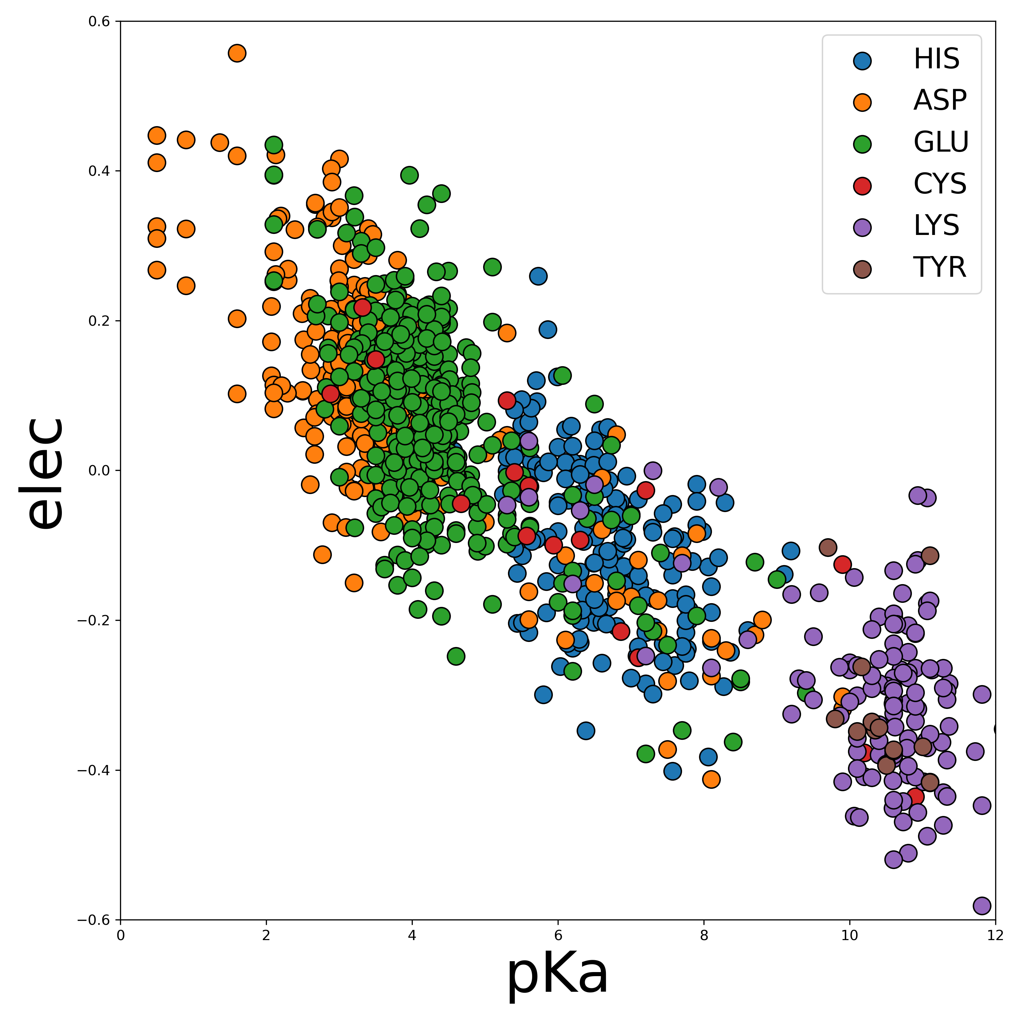
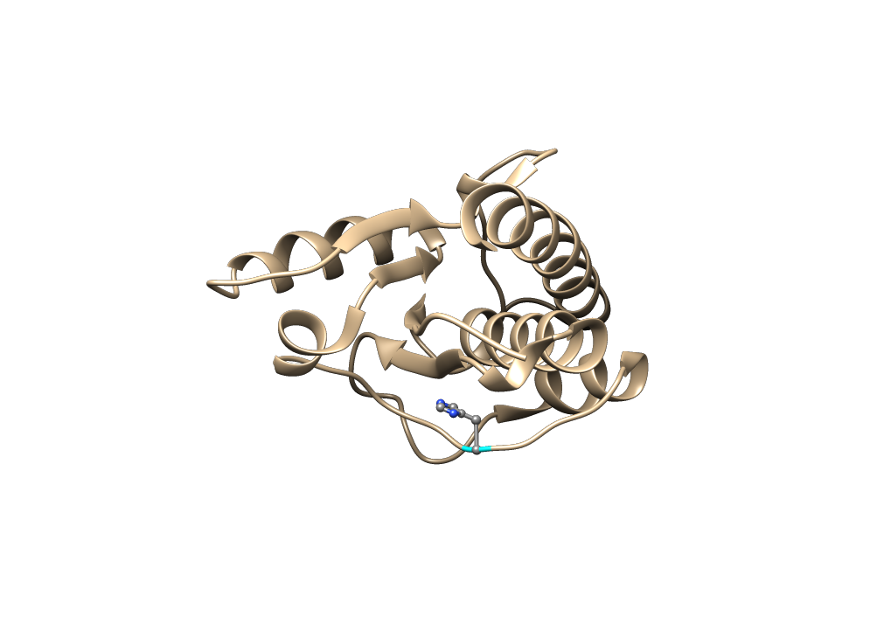
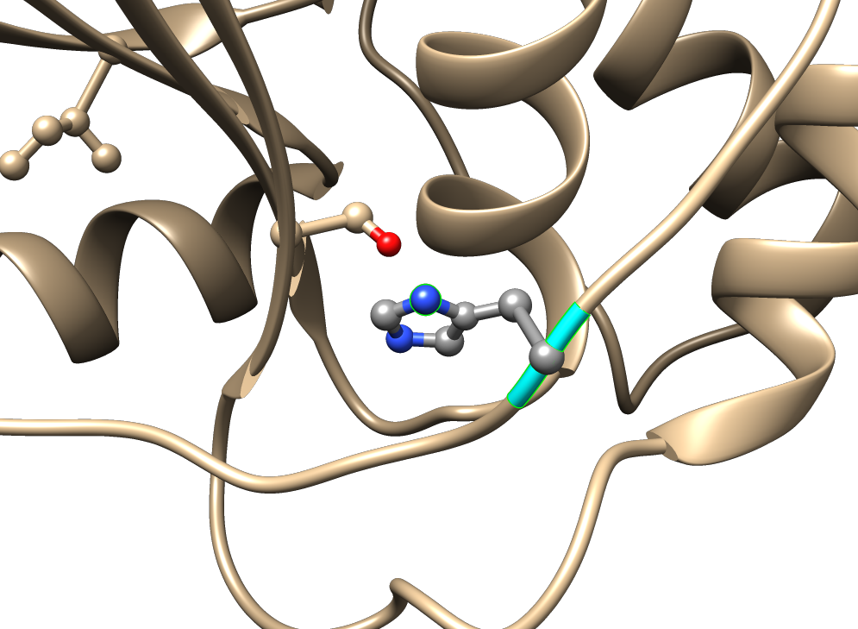
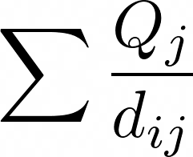
Electrostatic potential feature acquisition
Feature acquisition
PDB file curation
Atoms Distance (d_{ij})
Adding Water
Atoms Charges
Hydrogen
d₁
d₂
Protein PDB files were acquired from the protein database (PDB).
Water molecules and hydrogen atoms were added by the Amber21 tleap module.
Distance between the acidic hydrogen atom to all other atoms was calculated.
Electrostatic features were calculated by equation ∑ Qj/dij.

Slide 8
Ensemble learning
Model 1
Final Estimator
pKa
Dataset
Model 2
Model 3
Model Stack
Combines multiple models to improve performance
Each model is trained
Use a final estimator learn from the output of models
Improve accuracy and robustness of models
Use for classification, regression, or clustering tasks

Slide 9
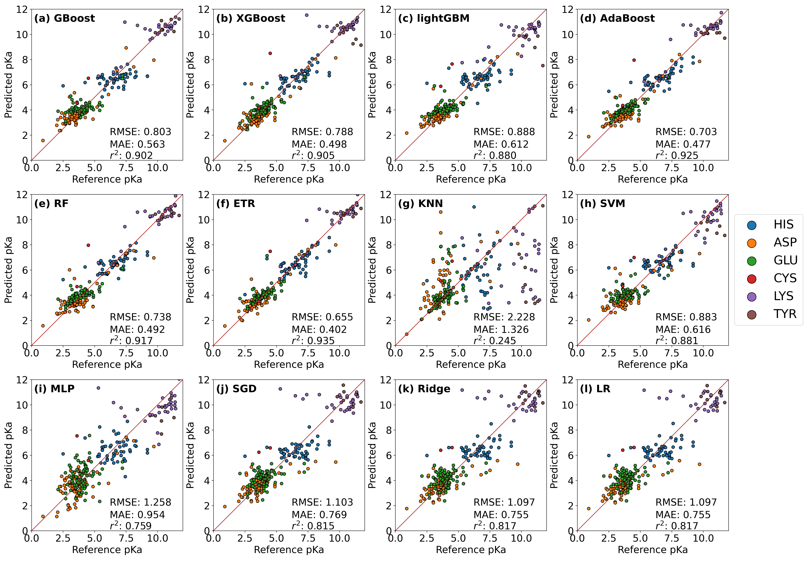
Machine learning algorithm selection (test set)
Ensemble
AdaBoost
RF
SGD
ETR
SVM
Conclusion:
AdaBoost, RF, ETR and SVM were the four high performance models.
SGD was picked as the final estimator since its flexibility and relatedly high accuracy.
Notes:
Models, x axis, y axis, metrics, performance
Multiple layer perceptron

Slide 10
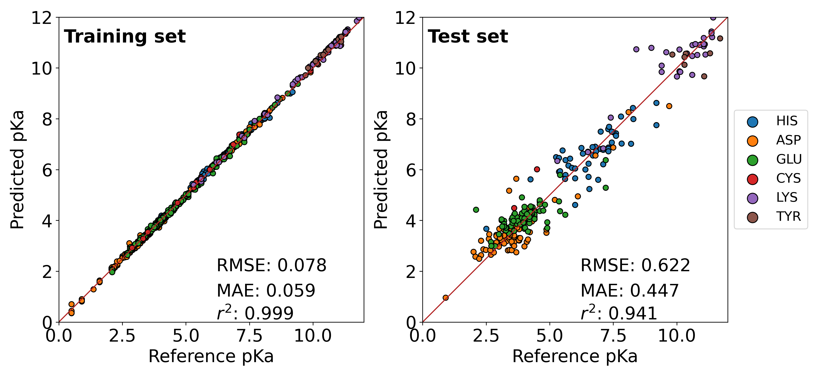
Ensemble model pKa prediction
Conclusion:
Ensemble model improved the pK_{a} prediction on RMSE and R² metrics.
Ensemble method outperformed the two published models
Model | RMSE | MAE | R²
Ensemble | 0.62 | 0.45 | 0.94
PROPKA | 1.10 | 0.7 | 0.3
Chen et al. | 0.69 | 0.42 | 0.93
Null | 2.64 | 1.99 | -0.06
Notes:
text book value for null.
r2 equation ,
Refer propka chen et al

Slide 11
Conclusion
Electrostatic potential was calculated and added to machine learning training features.
Ensemble learning model was built up and improved pKa prediction accuracy.

Slide 12
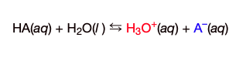
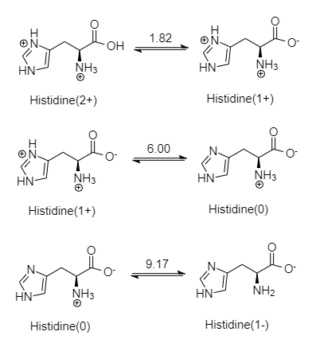
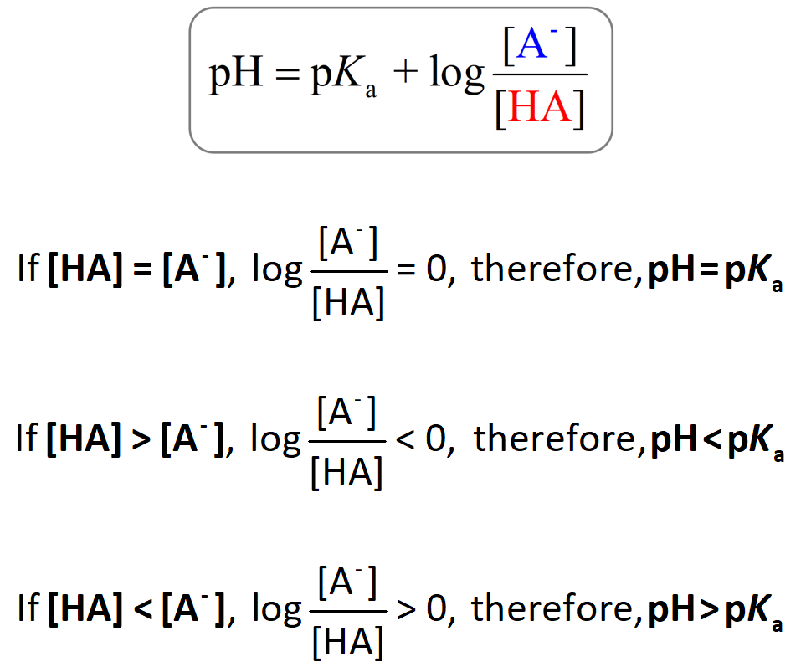
pKa is the negative base 10 logarithm of the acid dissociation constant, Ka.

